Slide 1



ATLANTIS
Snigdha Khanna Sourick Sinha
Salil Kumar Gaurav Paswan
Notes:
developed

Slide 2
Problem Statement
Wind energy is the largest source of renewable power as it is pollution and fuel free. The energy output of a wind farm is highly dependent on the wind conditions at site.
Our Aim:
To predict the energy output of wind turbine based on the climatic conditions
To develop an analytical Time Series forecast model
To suggest the best time to utilize the wind turbine
Notes:
SOU
Being renewable in nature, wind energy is fast becoming the cleanest energy source for commercialization.

Slide 3
Business Aspect
Costs for a utility scale wind turbine range from about $1.3 million to $2.2 million per MW of nameplate capacity installed.
Financial feasibility decision for installing windmills using predicted instantaneous Energy output for a particular time frame and at particular angle.
Forecasting business insights for use in website layout and marketing tactics.
Working with Big Data to achieve automation
Notes:
Commercial aspect of using ML models for better windmill integrated management systems.
Revolutionarize industries
Costly->critical to make informed decision
SOU

Slide 4
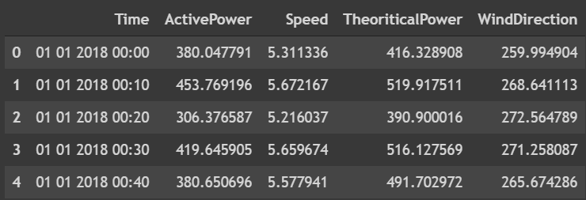
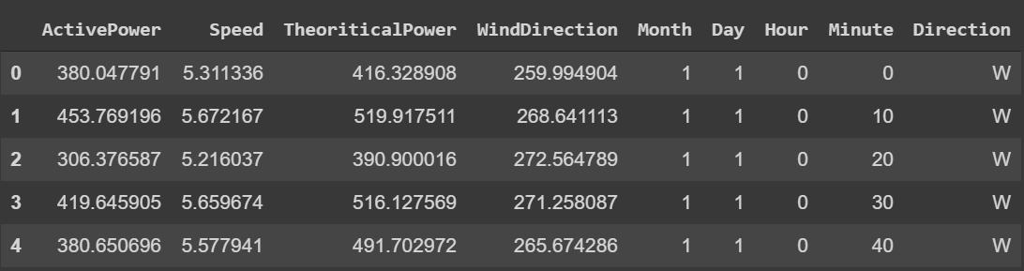
Dataset
The following figure shows a snippet of our dataset
The following figure shows the preprocessed, cleaned data
In Wind Turbines, Scada Systems measure and save data like wind speed, wind direction, generated power and so on for 10 minutes intervals.
For data preprocessing and cleaning;
Feature addition
Data cleaning
Data encoding
Data standardising
Train-Test split used: 80:20
Notes:
Source Kaggle website

Slide 5
Methodology
We used Agile Methodology for our project. A good approach employs iterations among three stages:
Data Collection/Reduction
Development and Analysis of Model
Variable Selection
For this purpose, we followed pair programming, had daily scrum and weekly sprint.
Notes:
Just mention and go to next slide:
Pair programming
Daily Scrum
Weekly meeting

Slide 6
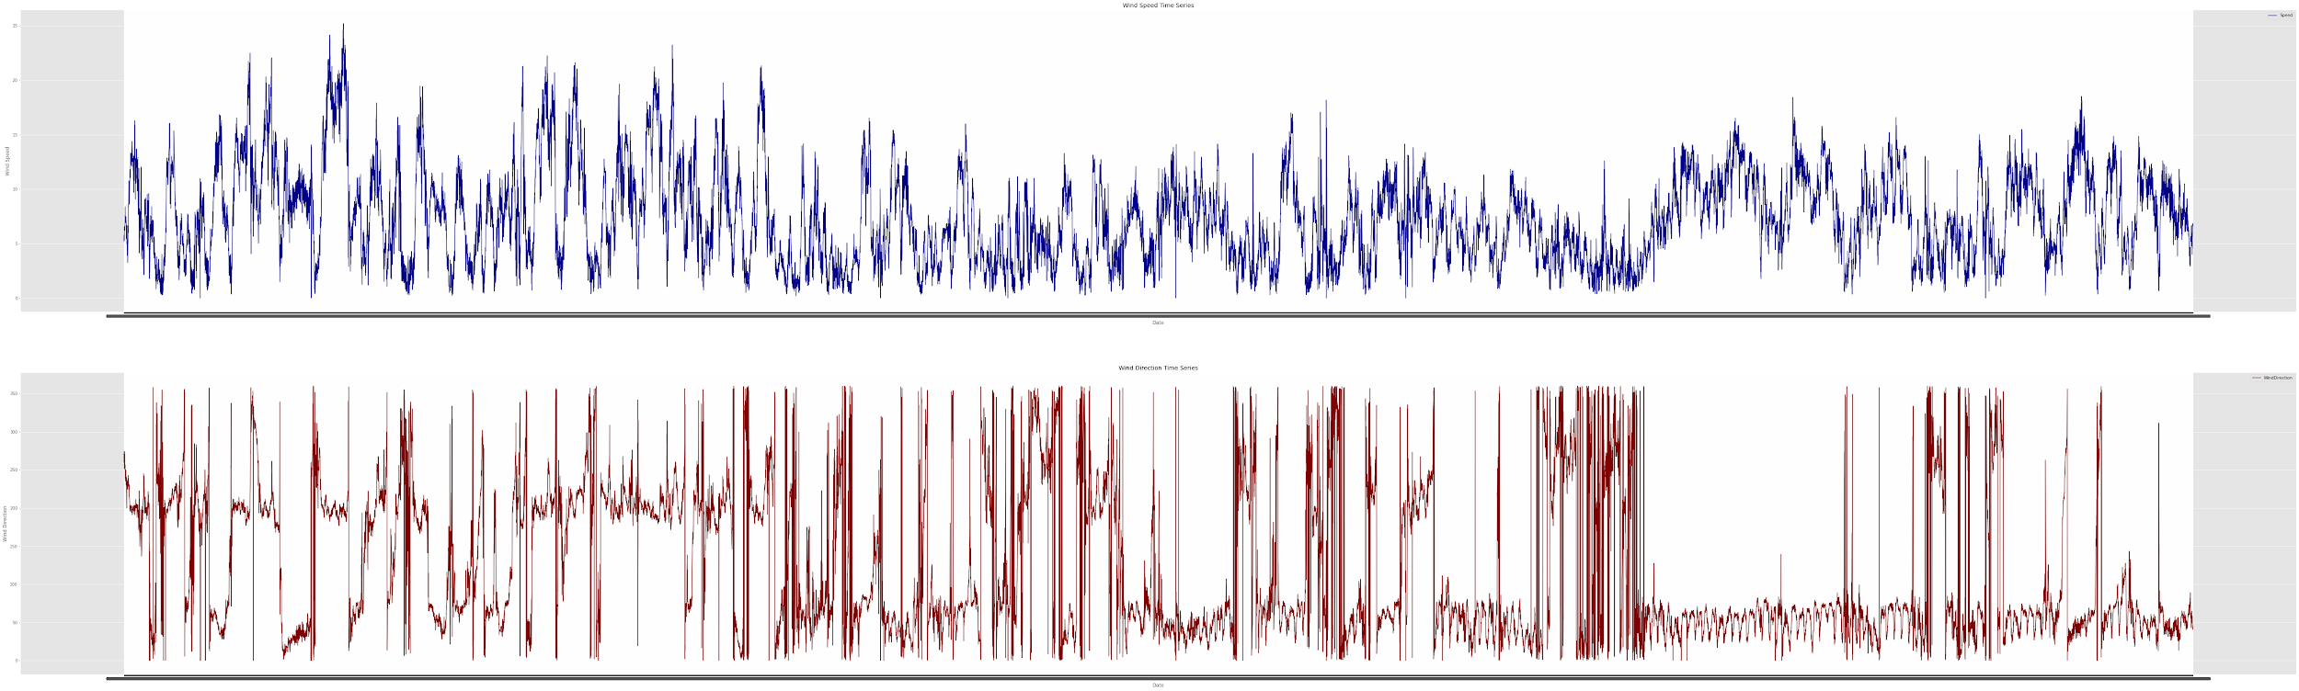
Time Series Analysis
Time Series Analysis has been done using Facebook Prophet(fbprophet)
Procedure for forecasting time series data based on an additive model where non-linear trends are fit with yearly, weekly, and daily seasonality, plus holiday effects.
The following figure shows the Time Series Trend for the entire dataset
(Wind Speed trend is shown in Blue and Wind Direction trend is shown in Red)
Notes:
SOU

Slide 7
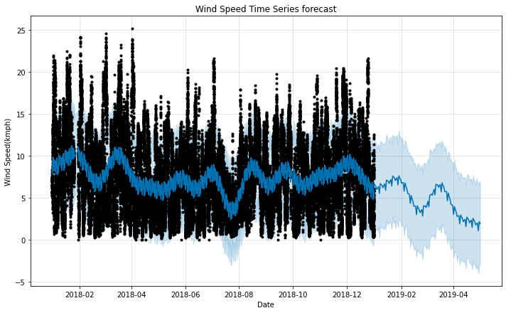
Time Series Analysis : Wind Speed
The following figure shows the Time Series Forecast for Wind Speed:
The overall forecast shows a steady value with occasional highs and lows.
In recent years, we see that the forecasted value is highest for the month of February and March, 2019
It hits an all time low of about 2 kmph around the month of May.
Notes:
Time series forecasts for each parameter in the dataset have been shown with black dots from 2018-01 to about 2019-01.
The dark blue plot across the graph shows the mean forecasted value for the corresponding parameter for the upcoming months
SOU

Slide 8
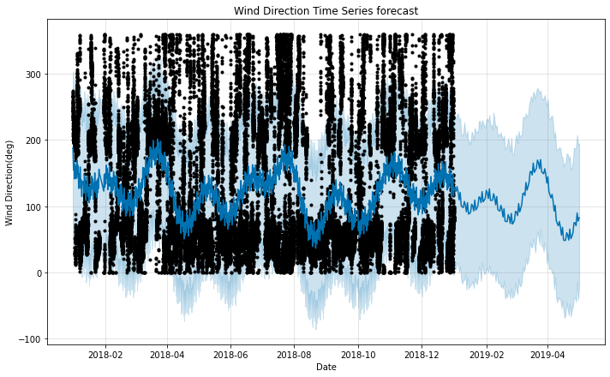
Time Series Analysis : Wind Direction
The following figure shows the Time Series Forecast for Wind Direction:
The overall forecast shows a steady value with occasional highs and lows.
In recent years, we see that the forecasted value is most favourable for the month of March and April, 2019
It is most unfavourable around the month of May.
Notes:
Time series forecasts for each parameter in the dataset have been shown with black dots from 2018-01 to about 2019-01.
The dark blue plot across the graph shows the mean forecasted value for the corresponding parameter for the upcoming months
SOU

Slide 9
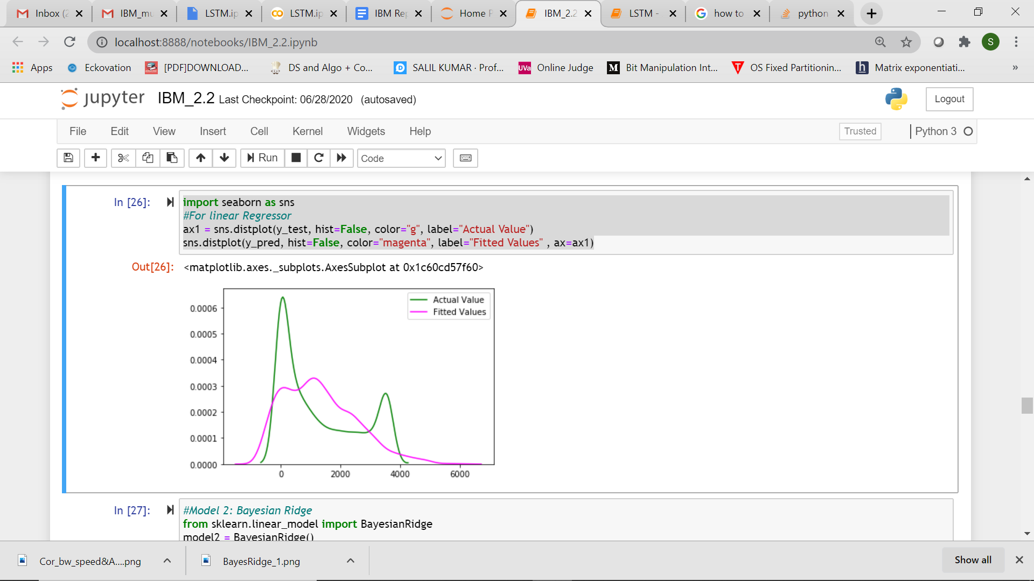
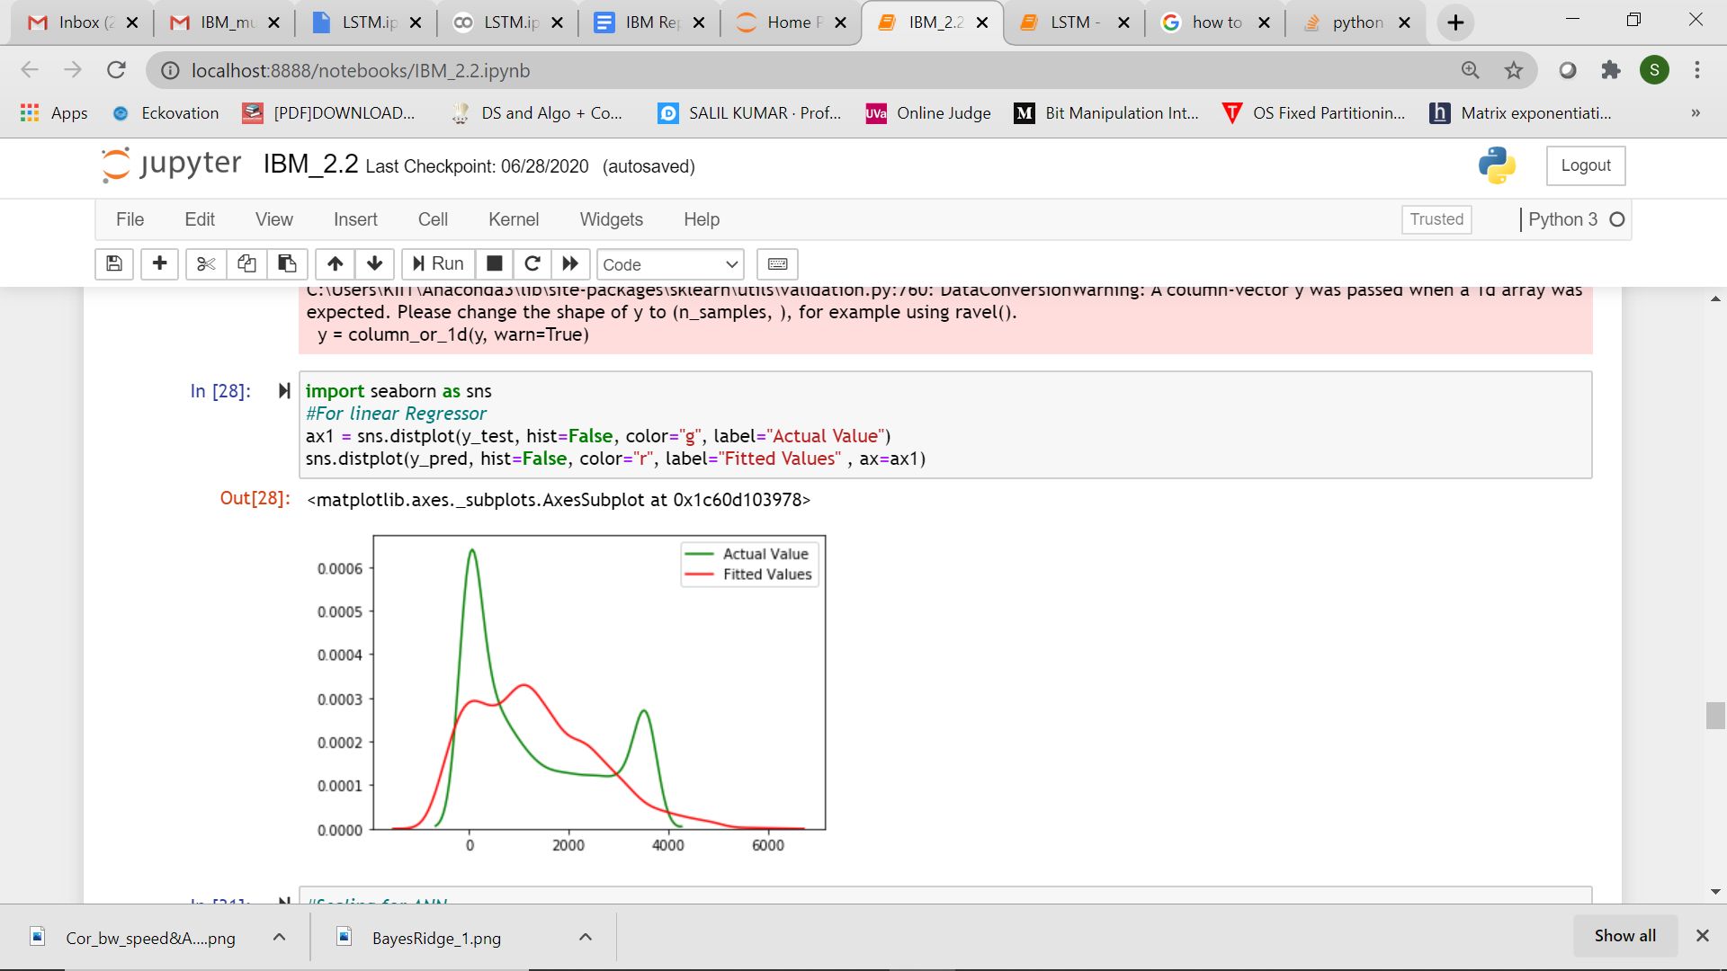
Models Used
We have implemented following models:
Linear Regressor
Bayesian Ridge Regressor
Random Forest Regressor
LSTM(Long Short Term Memory) neural network
The prediction plot for Linear Regression and Bayesian Ridge Regression is given alongside.
Notes:
right : linear and Bayesian ridge actual and fitted plots: pretty similar
SOU

Slide 10
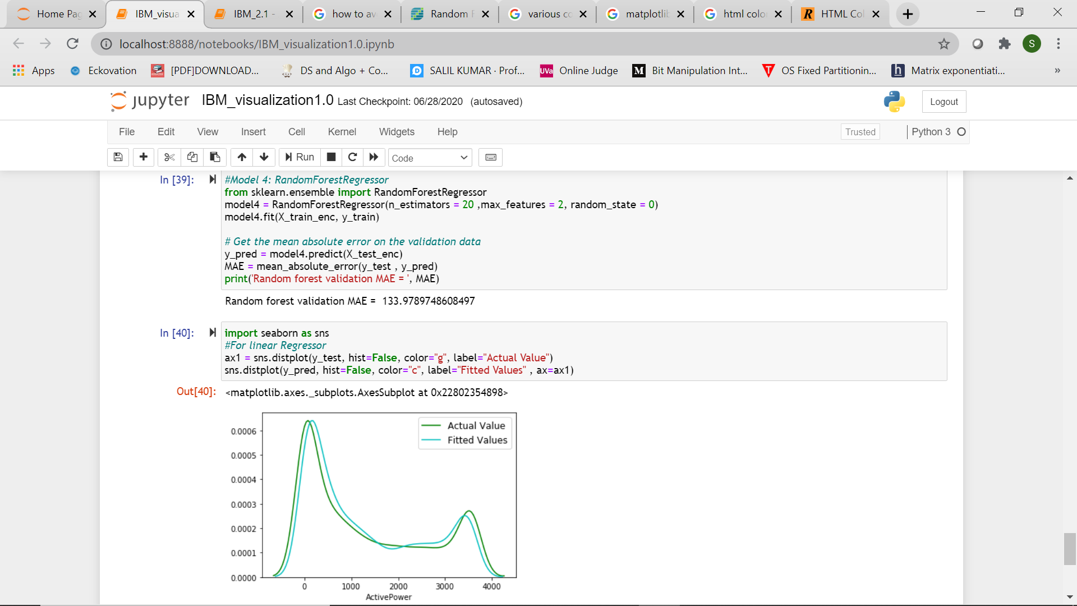
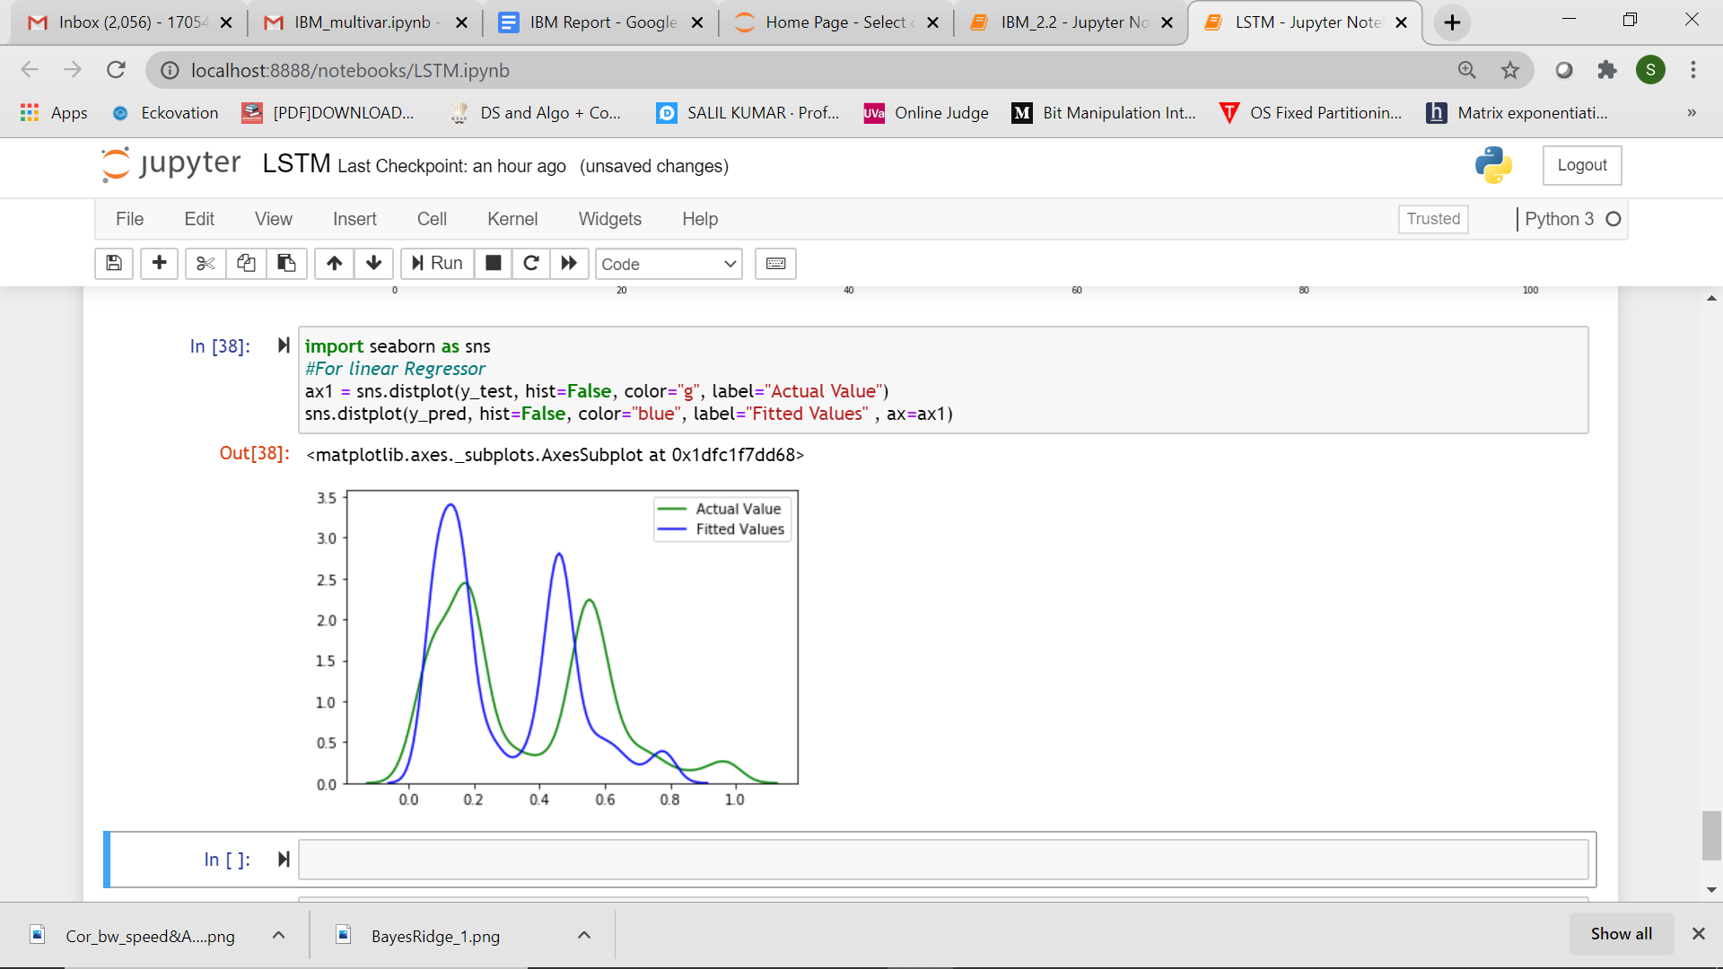
Model Selection
The MSE values for each models were calculated and graphs were plotted showing the performance of the models.
Random Forest Regressor was selected as it gave the highest accuracy with least training time among all models.
MODEL | Linear Regression | Bayesian Ridge Regression | RandomForest | LSTM
ACCURACY(%) | 84 | 84 | 97 | -
MSE | 529.59 | 529.59 | 214.89 | 0.11827(0-1)
Notes:
Explain reasoning

Slide 11
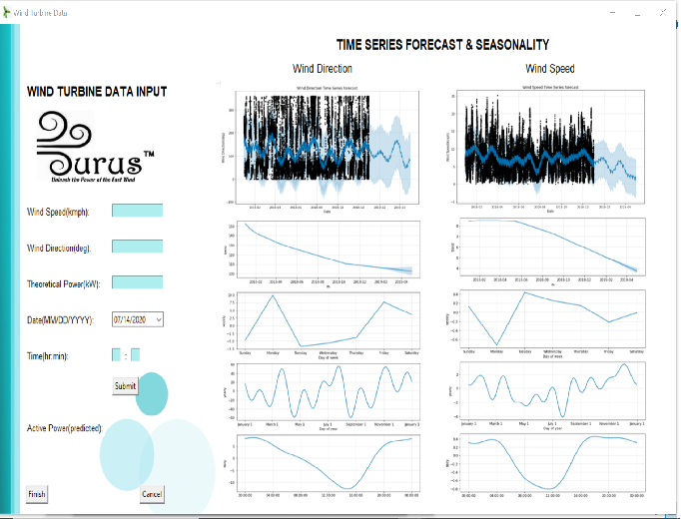
Graphical User Interface: GUI
Python when combined with Tkinter provides a fast and easy way to create GUI applications
Python Tkinter provides a powerful object-oriented interface to the Tk GUI toolkit.
Notes:
We will show in live demo

Slide 12
Conclusion
Eurus SystemsTM has the following functionalities:
Make near accurate forecasts for upcoming months
Make near accurate predictions for the Active Power to be generated
User-friendly GUI
Dataset updation by backend ML models
Could we be any happier?

Slide 13
Future Scope
To broadcast our application as an android application or website service
To handle multiple user requests simultaneously
Use of centralized database on cloud service for the same
Reducing the running time for models
To incorporate data for the more recent years so that more current forecasts can be accurately done.
“If you aim higher than you expect, you could reach higher than you dreamed.”
~Richard Branson
Notes:
Inclusion if newer insights or predictions as per need

Slide 14
The Team
“The strength of the team is each individual member. The strength of each member is the team.”
~Phil Jackson
Team ATLANTIS is a quartet comprising Snigdha, Salil, Sourick and Gaurav.
This hackathon could not have achieved successful completion without adequate team efforts on behalf of each of them. Each of us made up for what another was lacking, making it a beautiful opportunity to collaborate and learn all along.
We will be ready for more!
Regards,
Team ATLANTIS

Slide 15


